Slide 1
SEMPHY01
Hall Effect

Slide 2
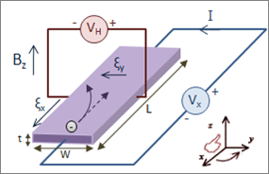
Hall Effect Machine

Slide 3
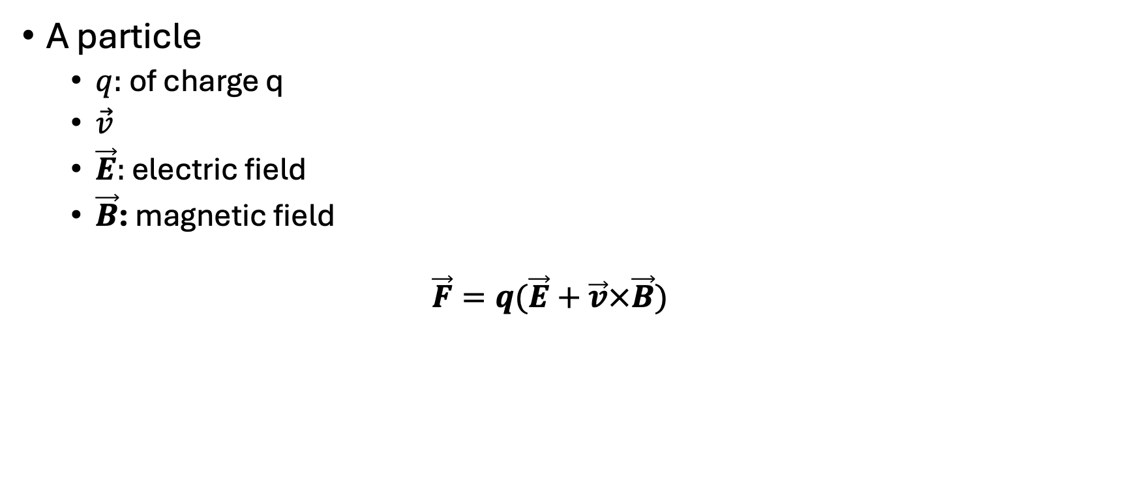
Lorenz Force
A particle
  $q:$ of charge q
  $\vec{v}$
  $\vec{E}:$ electric field
  $\vec{B}$: magnetic field
  $$\vec{F}=q(\vec{E}+\vec{v}×\vec{B})$$

Slide 4

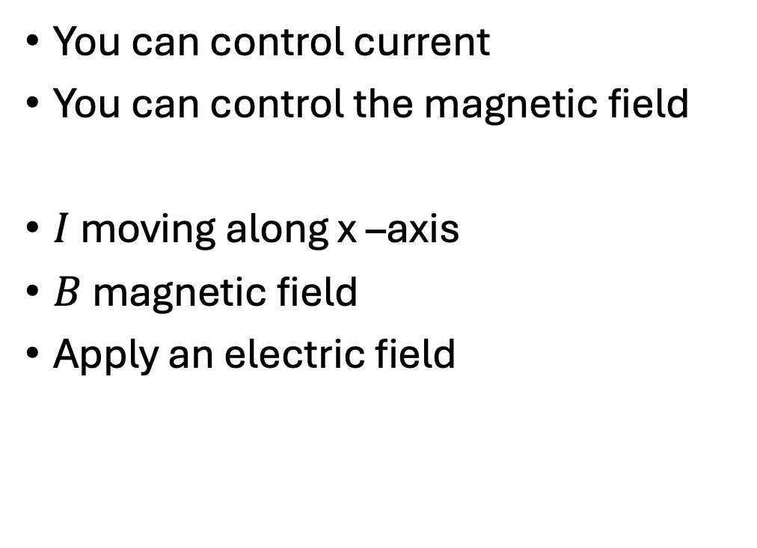
Hall effect machine
You can control current
You can control the magnetic field
$I$ moving along x –axis
$B$ magnetic field
Apply an electric field

Slide 5
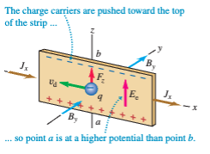
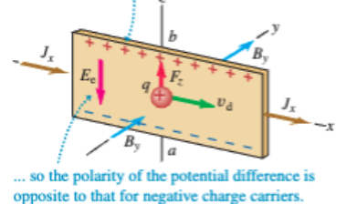

Slide 6





Steady state condition of Hall Effect
$$E_{H}=v_{d}B$$
Drift velocity

Slide 7
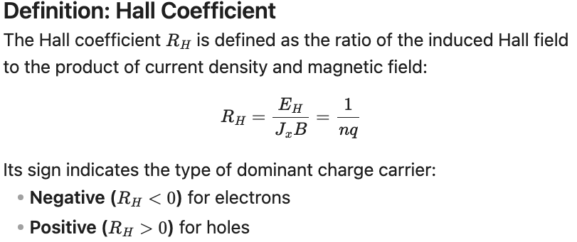
Call Coefficient

Slide 8
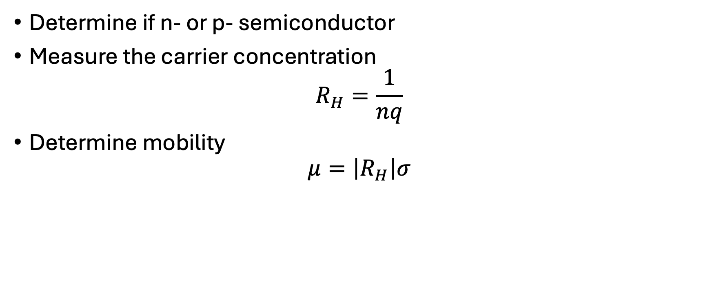
Hall effect allows you to get a variety of different effects
Determine if n- or p- semiconductor
Measure the carrier concentration
$$R_{H}=\frac{1}{nq}$$
Determine mobility
$$μ=\left|R_{H}\right|σ$$

